Slide 1
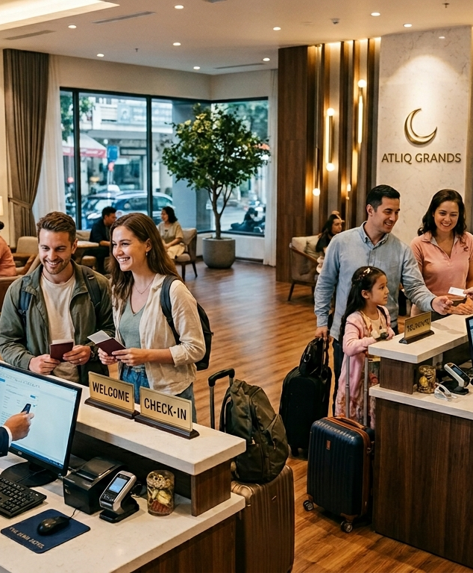


Hotel Revenue Analysis & Business Insights for AtliQ Grands
AtliQ Grands is a well-established hotel in India with over 20 years of experience in the hospitality industry

Slide 2
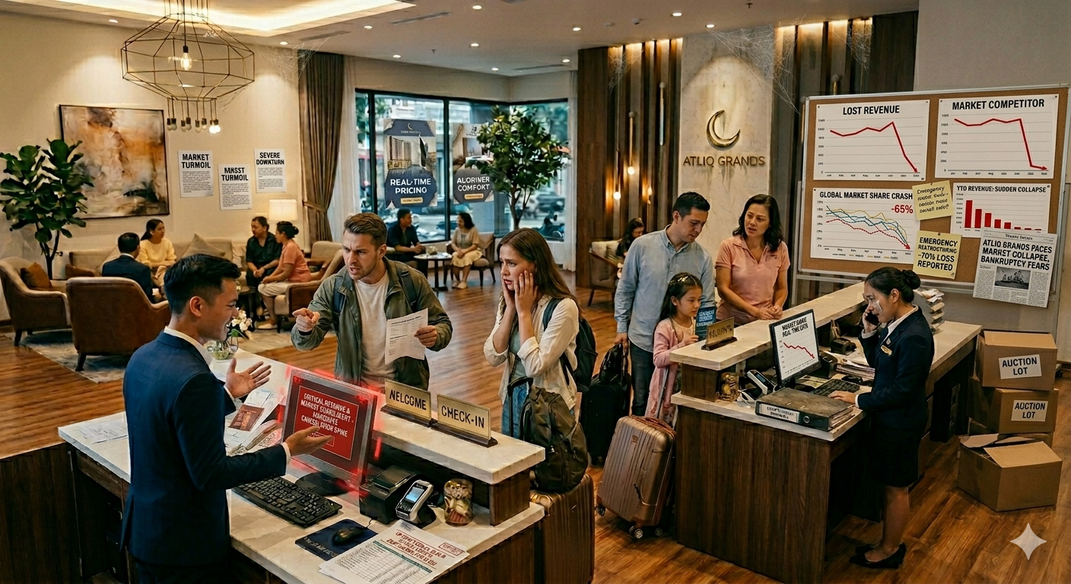


Problem Statement :
AtliQ Grands is experiencing a decline in overall business performance, including revenue and market position. The main challenges include:
Lack of data-driven decision-making
Increasing competition in the hotel industry
Inefficient analysis of business performance
No dedicated analytics team for insights generation
Because of these issues, the company struggles to clearly understand performance across different business areas such as bookings, occupancy, and revenue trends

Slide 3
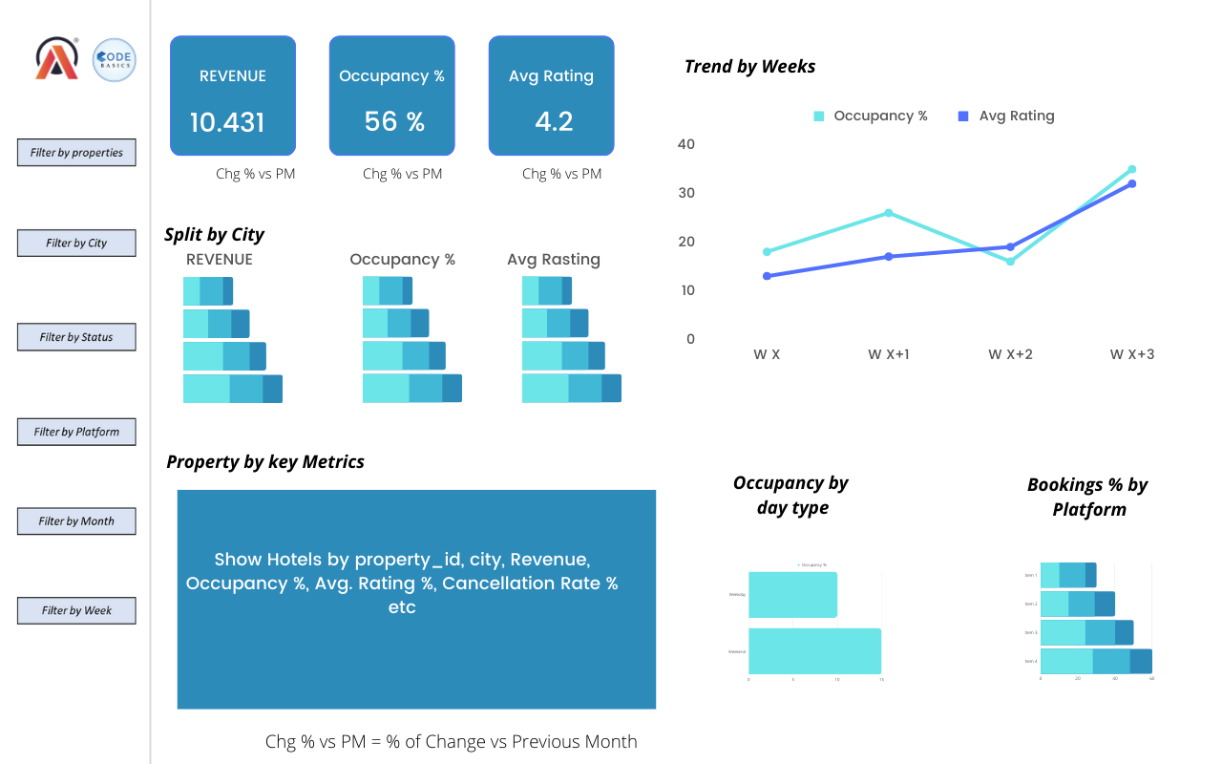


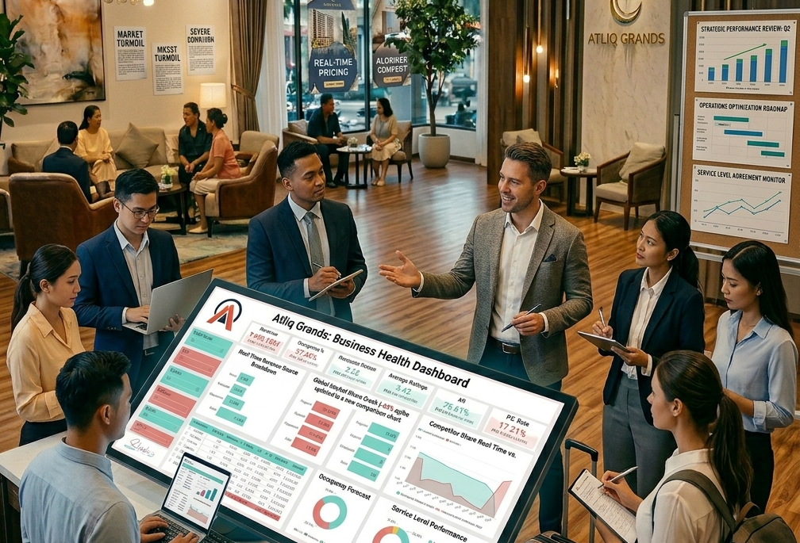
Project Objective
The primary objective of this project is to leverage data analysis and visualization techniques to evaluate overall hotel business performance and support informed decision-making.
Create key performance metrics from the given dataset
Develop an interactive dashboard based on stakeholder requirements
Analyze data to generate insights across multiple business views
Support strategic and operational decision-making through data-driven insights

Slide 4
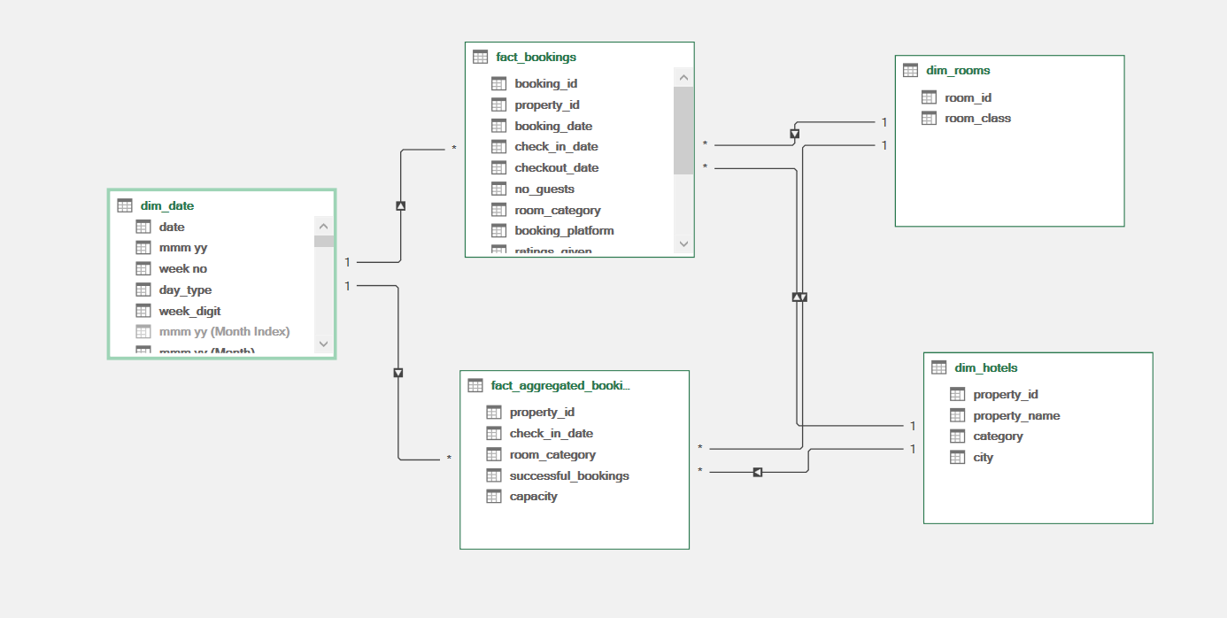

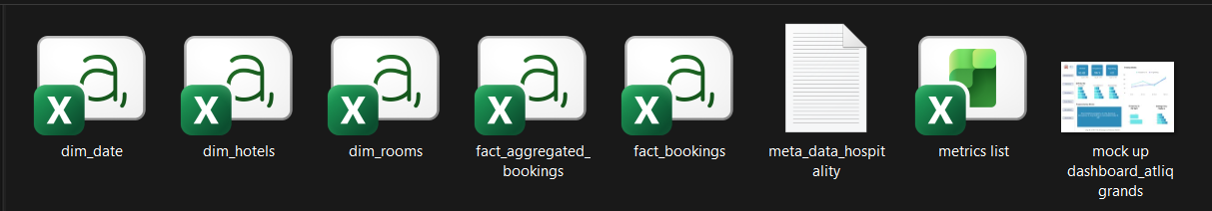

DATA SOURCE & DATA MODELING
DATA SOURCE :
DATA MODELING:
The dataset for this project consists of multiple CSV files provided for analysis and dashboard development:
2 Fact Tables
3 Dimension Tables
1 Metadata File
1 Mock-up Dashboard Image
1 Metrics File
This structured data enables comprehensive analysis from multiple business perspectives.
Data modelling was performed to establish relationships between fact and dimension tables. By connecting the tables using common columns (keys), a structured data model was created.
This approach helps to:
Improve data consistency and accuracy
Enable efficient data analysis across multiple tables
Increase flexibility while creating calculations and dashboards
The relationships allow seamless integration of data, making it easier to generate insights and build interactive visualizations.

Slide 5

















DATA CLEANING AND PREPROCESSING
Data Cleaning and
Preprocessing
Data Type
Handling Data
Handling Missing
Feature
Conversion
Inconsistency
Values
Engineering
Some columns were converted to appropriate data types to ensure efficiency and accurate calculations.
The fact booking table contained data for 4 months, while the date dimension table included only 3 months.
To maintain consistency in the data model, the extra one-month data was filtered out from the booking table.
Missing values in one of the columns were handled by replacing them with the average value, ensuring minimal impact on analysis.
A new column, Week Number, was created to support proper sorting and better time-based analysis.

Slide 6






DASHBOARD ARCHITACTURE
The dashboard is designed to provide a comprehensive view of overall business performance through five key analytical views, each focusing on a specific aspect of the hotel operations.
Revenue &financial view
Occupancy & capacity view
Customer behaviour view
Customer experience view
Executive overview

Slide 7
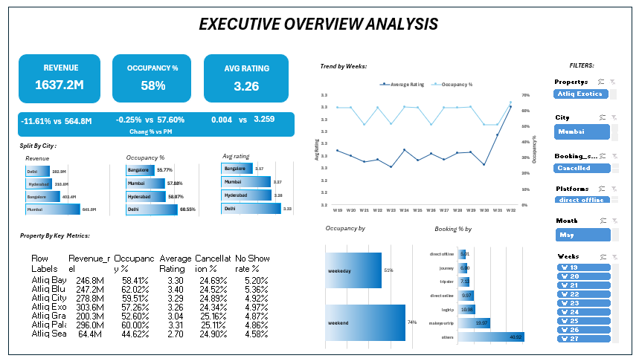


Executive overview insights :
Revenue declined by 11.61%, while occupancy (~58%) and ratings (~3.26) remained stable.
👉 Indicates issue with pricing or revenue strategy, not demand.
Mumbai is the top revenue contributor, while Delhi has highest occupancy but lowest revenue.
👉 Suggests pricing imbalance across cities.
Atliq Seasons is underperforming in both revenue and occupancy.
👉 Needs improvement or strategic review.
Weekend occupancy (74%) is much higher than weekdays (51%).
👉 Shows weak weekday demand.
🚀 Recommendations
Optimize pricing (ADR) to fix revenue drop
Increase weekday demand (offers, corporate bookings)
Adjust city-level pricing strategies
Improve or review underperforming properties
Enhance customer experience to boost ratings
Analyze recent revenue drop trend and apply seasonal strategies

Slide 8
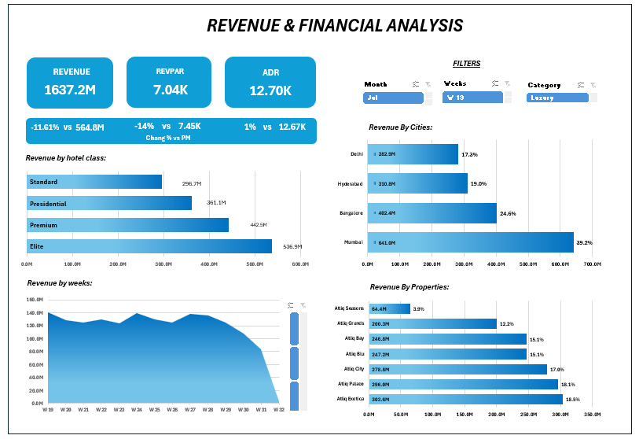
Revenue & Financial insights:
RevPAR declined by 14%, while ADR increased by 1%.
👉 Indicates lower revenue efficiency, possibly due to reduced occupancy or ineffective pricing/discount strategy.
Elite category generates the highest revenue (~536.9M), followed by Premium, while Standard is the lowest (~296.7M).
👉 Suggests lower demand or weaker value perception in Standard category.
Weekly revenue trend shows fluctuations with a sharp drop in Week 32.
👉 Indicates possible seasonal drop or external factors affecting demand.
City and property insights remain consistent with earlier findings (Mumbai leading, some properties underperforming).
🚀 Recommendations
Improve RevPAR by balancing pricing and occupancy
Enhance Standard category (better services, pricing, offers)
Investigate Week 32 drop and apply corrective strategies
Optimize discount strategies to avoid revenue loss
Focus on high-performing categories while improving low-performing ones

Slide 9
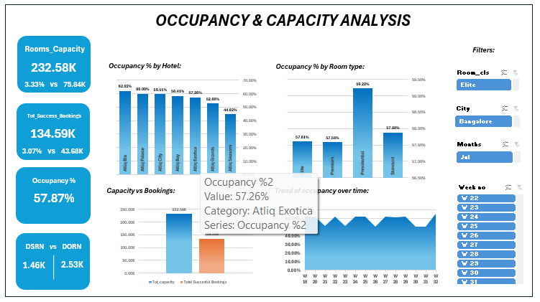


Occupancy & capacity insights:
Overall occupancy is ~57.87%, indicating moderate utilization of available capacity.
Total capacity (232.58K) is much higher than successful bookings (134.59K).
👉 Shows underutilization of available rooms.
Occupancy by hotel shows variation across properties, with some performing well (~60%+) and others significantly lower (~44%).
👉 Indicates uneven performance across hotels.
Occupancy by room type:
  Presidential rooms have highest occupancy (~59%)
  Other categories (Elite, Premium, Standard) are slightly lower
  👉 Higher-end rooms are performing better than expected.
Trend over time shows fluctuations but no strong growth pattern.
👉 Indicates inconsistent demand.
🚀 Recommendations
Improve occupancy rates through targeted marketing and better pricing strategies
Focus on underperforming properties and optimize their operations
Increase utilization of available capacity (promotions, partnerships, campaigns)
Boost demand for lower-performing room types through offers or bundling
Stabilize demand trends using seasonal planning and demand forecasting

Slide 10
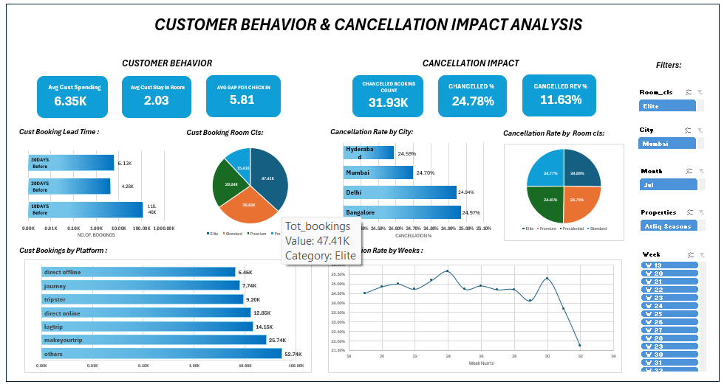


Customer behavior & cancellation insights:
🔹 Customer Behaviour
Average customer spending is 6.35K, with an average stay of ~2 days.
Most bookings are made 20–30 days in advance.
👉 Indicates short stay duration and moderate planning window.
Elite room class has highest bookings (~47%).
👉 Shows preference for higher-value room categories.
Major bookings come from MakeMyTrip, Longtrip, and Direct Online channels.
👉 Business Is highly dependent on online platforms.
🔹 Cancellation Impact
Total cancellations: 31.93K (24.78%)
Revenue loss due to cancellations: 11.63%
👉 Significant impact on overall revenue.
Cancellation rates are similar across cities (~24–25%)
👉 Indicates a system-wide issue, not location-specific.
Cancellation trend fluctuates, with a sharp drop in recent weeks
👉 Needs further monitoring for consistency.
🚀 Recommendations
Reduce cancellations by improving booking policies (partial payments, stricter rules)
Offer incentives for confirmed stays (discounts, loyalty benefits)
Strengthen high-performing booking platforms
Encourage longer stays through package deals
Analyze cancellation reasons to take targeted actions

Slide 11
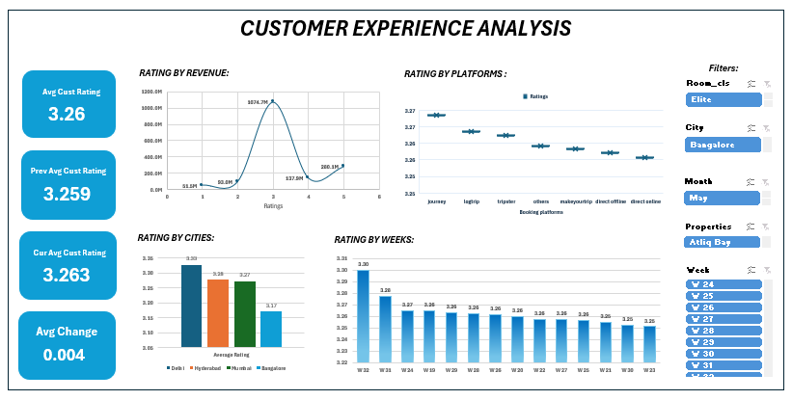

Customer Experience insights:
Average rating is ~3.26, showing moderate customer satisfaction with minimal change over time.
Ratings vs Revenue shows higher revenue around mid-level ratings (~3–4).
👉 Indicates most bookings come from average satisfaction levels, not excellent experiences.
City-wise ratings:
  Delhi has highest ratings (~3.38)
  Bangalore has lowest (~3.17)
  👉 Customer experience varies across cities.
Platform-wise ratings show slight variation, with some platforms performing better than others.
👉 Indicates inconsistent experience across booking channels.
Weekly trend shows ratings are stable but slightly declining.
👉 No strong improvement in customer satisfaction.
🚀 Recommendations
Improve overall service quality to push ratings above 3.5+
Focus on low-performing cities (e.g., Bangalore)
Standardize experience across booking platforms
Collect and act on customer feedback regularly
Enhance customer engagement and loyalty programs

Slide 12
Conclusion
This project provides a comprehensive analysis of AtliQ Grands’ overall business performance using data-driven insights. The analysis reveals that the decline in revenue is primarily driven by inefficiencies in pricing, high cancellation rates, and uneven performance across cities and properties, rather than a lack of demand.
While occupancy levels remain relatively stable, there is significant scope for improvement in revenue optimization, weekday demand, and customer experience. Additionally, high dependency on specific cities and booking platforms highlights potential business risks.
By implementing better pricing strategies, improving service quality, reducing cancellations, and optimizing underperforming areas, AtliQ Grands can enhance its market position and achieve sustainable growth.

Slide 13

Thank you so much yo yooo….

